Slide 1
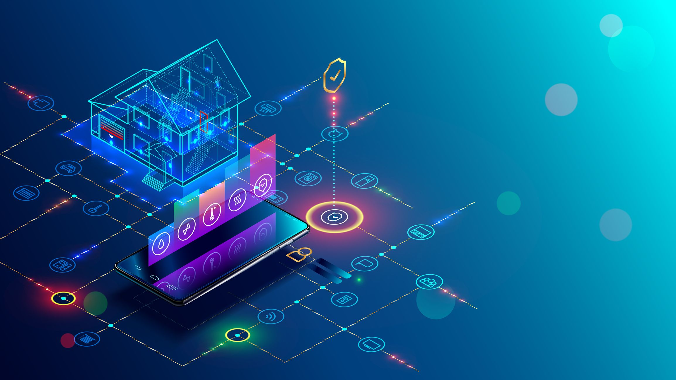

Presentation On IoT based Smart Home Automation System
Presented By Mobarak Hosen Roll: 1418006

Slide 2
Contents
Internet of Things
Trends of IoT
Home Automation
Why we need Home Automation?
Methodology of Home Automation
Model Architecture
Implementation of Hardware
Detection the presence of user
Project Features
Future of Home Automation

Slide 3
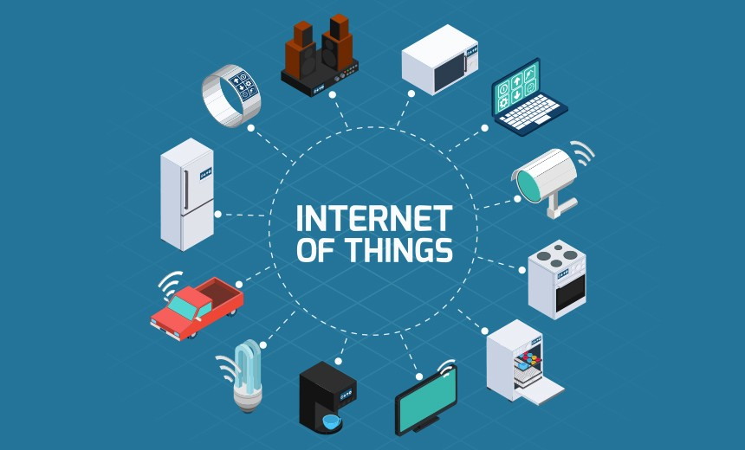
Internet of Things
The Internet of Things (IoT) is the interconnection of “things” through the internet to collect and exchange data.
The Home Automation is one of the main fields of application of IoT.

Slide 4
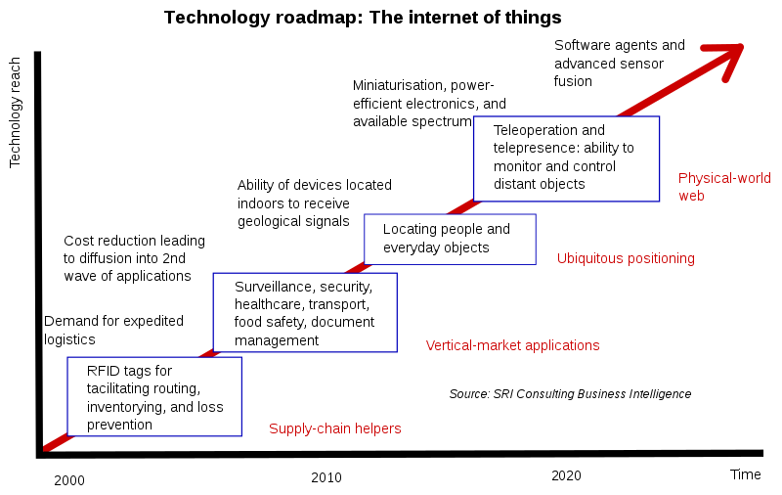
Trends of IOT
The IoT's major significant trend in recent years is the explosive growth of devices connected and controlled by the Internet.
The number of IoT devices increased 31% year-over-year to 8.4 billion in the year 2017 and it is estimated that there will be 30 billion devices by 2020. The global market value of IoT is projected to reach $7.1 trillion by 2020.

Slide 5
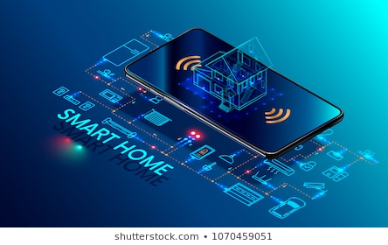
Home Automation
Home automation is building automation for a home, called a smart home or smart house. A home automation system connects the non-internet-enable devices to a central hub or “gateway” which are controlled and monitored remotely over the internet.
The home automation market was worth US$5.77 billion in 2013, predicted to reach a market value of US$12.81 billion by the year 2020.

Slide 6
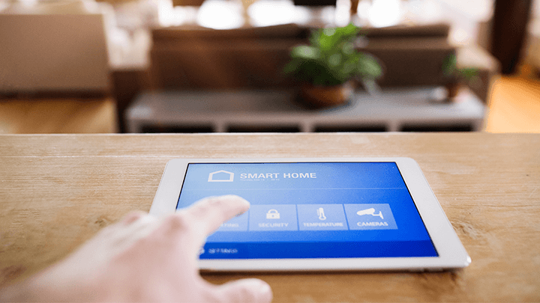
Why we need Home Automation?
Savings
Safety
Convenience
Control
Comfort
Peace of Mind

Slide 7
Methodology of Home Automation
Model Architecture.
Implementation of Hardware.
Detection the presence of user.

Slide 8
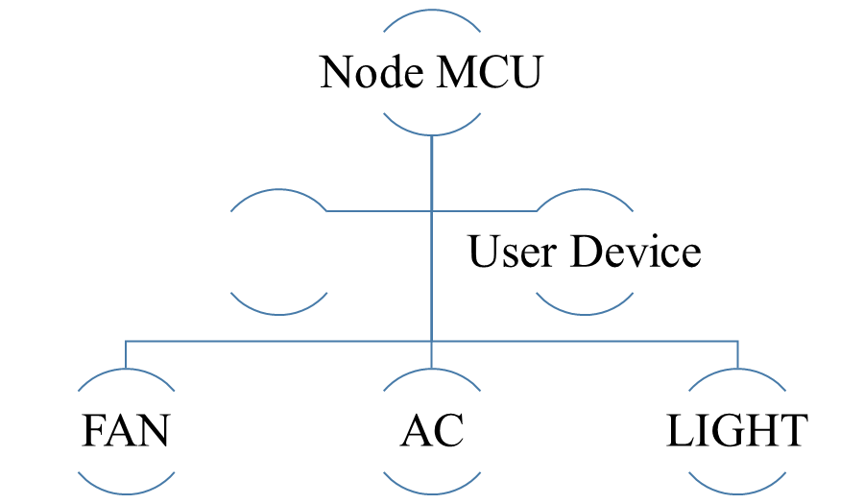

Model Architecture
The following figure describes the Block Diagram of Auto Control System.

Slide 9
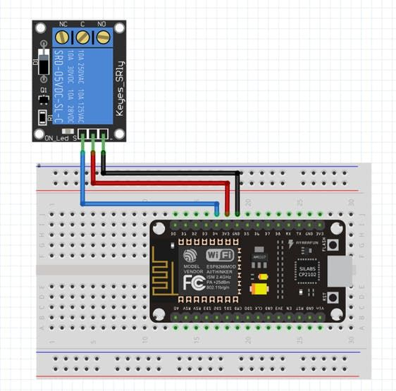
Implementation of Hardware
The following figure describes the Pin configuration between a single relay channel and the Node MCU (ESP8266).

Slide 10
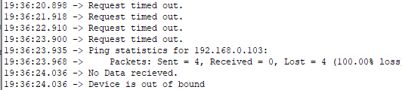
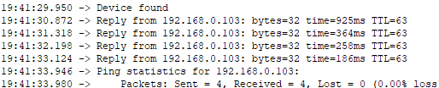
Detection the presence of user
Figure 1: When Phone is not connected to the router.
By using the feature of Internet Control Message Protocol (ICMP) we can pinging the static IP of user’s smartphone to detect the presence of user.
Figure 2: When Phone is connected to the router.

Slide 11
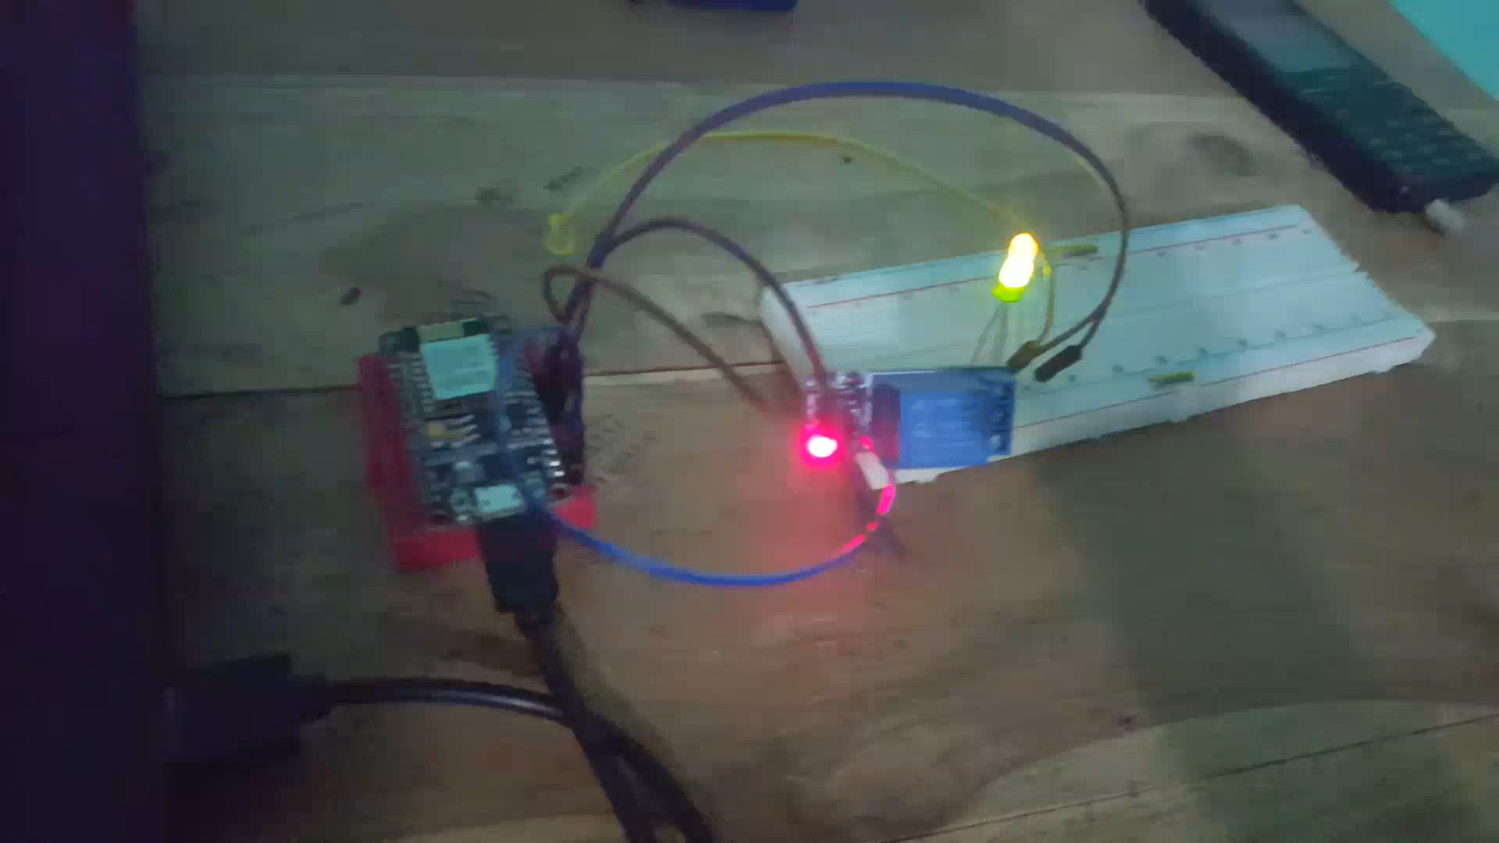
Working view
Have a look on this video to see how this project works.

Slide 12
Project Features
Automatic Fan, Light & AC control
Saving Energy by controlling power supply
Low costs project
Easy Installation

Slide 13
Future of Home Automation
There are several new technologies which can become a part of home in the near future:
Increased efficiency, control & customization.
Integration of Smart home devices.
Smart spaces outside homes.
Development of smart appliances.
Personal home delivery.
Everything will be connected…

Slide 14
Have any Question?

Slide 15
Thanks…

